Slide 1
Fake News Detection
Fascilitator : Reza Dibaj
Created by:
Deval Shah (xxxxxx807)
Neha Joseph (xxxxxx187)
Roshna babu (xxxxxx012)
Riyaben Gajjar (xxxxxx043)
Abraham Mathew (xxxxxx875)

Slide 2
INTRODUCTION
Fake news refers to news that may or may not be true and is widely disseminated via
social media and other internet platforms.​
1
We aim to give users the ability to classify news as fake or real, as well as verify the legitimacy of the website that published it
2
In this project, we aim to conduct binary categorization of various news items available online with the use of concepts pertaining to Artificial Intelligence, Natural Language Processing, and Machine Learning. ​
3

Slide 3
RATIONALE STATEMENT
Rapidly increasing technology, information sharing has become an easy task. Without a doubt, we can say that the internet has made our lives easier and provided us with access to a wealth of knowledge.
1
Technological advancements and the dissemination of news through many forms of media have worsened the spreading of fake news today
2
The datasets available in internet for the fake news challenge is insufficient for our purposes because it only contains ground truth about text relationships, not whether those texts are true or false assertions.
3

Slide 4
PROBLEM STATEMENT
Text, or natural language, is a tough form to comprehend due to a variety of linguistic traits and styles such as sarcasm, metaphors
To develop a fake news detection system using natural language processing and its accuracy will be tested using machine learning algorithms
To develop algorithms that can distinguish the fake articles from actual or human-written informationis a difficult task.
It is difficult and time-consuming to detect fake news based on news content.
1
2
3
4

Slide 5
APPROACH
Fake news detection on a public dataset using Classification Algorithms.
Collecting the required dataset.
Evaluating the best classification Algorithm for the model on prepossessed data.
Opting the best algorithms between PAC, KNN, Logistic Regression, Random Forest, Decision Tree, Naïve Bayes.
Testing with live demo on the chosen algorithm.

Slide 6
DATA REQUIREMENTS
Data requirements are usually the data items which are necessary for the analysis. While considering the data analysis part of fake news detection
1
It should have text data which contains articles in it, hence the text data could be vectorized and tokenized and later could be used for analysis.
2
Another point is that the data assembled should be shuffled well as we do not want any error or difference in evaluation as all the fake news are residing together, as it may affect the accuracy and results of the algorithm.
3

Slide 7

DATA
After several research and studies, we have chosen the necessary datasets from Kaggle. We have opted for two datasets which are essential for the analysis.
The news articles are obtained from certain news reporting medias. And the news reports were generated between January 2016 and December 2017.
As the analysis is related to fake news detection the dataset contains the information regarding certain articles which are addressed as Fake or True.
Each dataset contains 4 columns in it, which are Tile, Text, Subject and Date. The two datasets are fake news dataset and True news dataset.
Fake and real news dataset | Kaggle

Slide 8
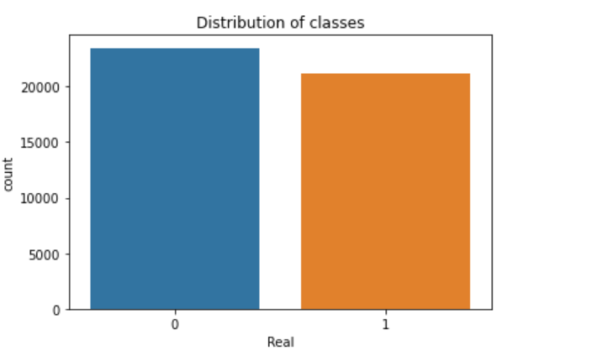
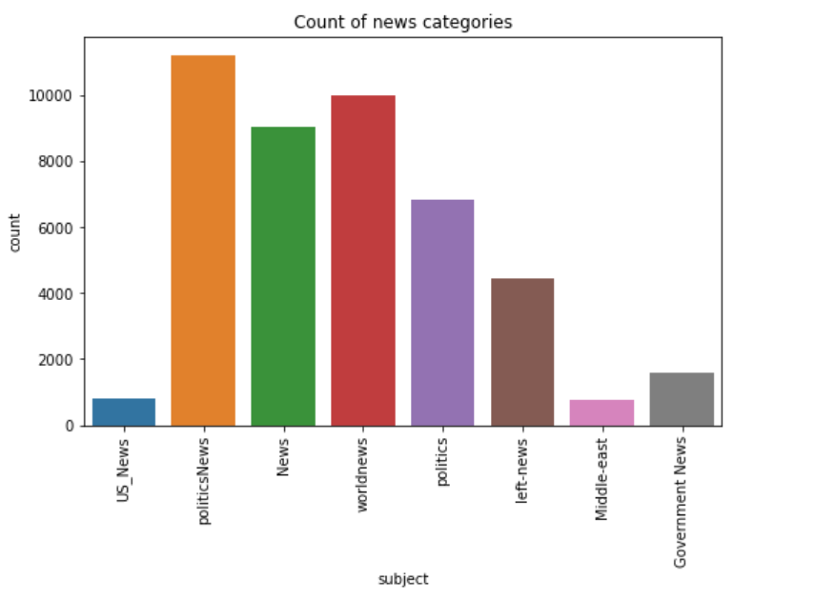
EDA

Slide 9
DATA PRE-PROCESSING
Acquire the dataset
Import libraries
Import the dataset
Feature scaling
Splitting the dataset
Encoding the categorical data
Identifying and handling the missing values

Slide 10
MODEL ARCHITECTURE
Data Collection
Data Exploration
Data Prepossessing
We have opted four datasets and out of which we have finalized on Fake and real news dataset | Kaggle .
The Exploration of the Data contains certain things such as loading the data, checking the data information, and evaluating the data understanding
Pre-processing is done to identify the errors and unwanted noises present in the dataset and eliminate those things from the dataset.
Model Evaluation
Model training
Algorithm Selection
There are certain techniques to do the model evaluation such as Mean absolute error, R-Squared, confusion matrix, Accuracy Score, Precision and Recall, Auc-Roc curve.
Model training is done in data analysis to train the data. The training of the model is done to check the performance of the data.
To select the algorithm, we must consider certain things such as the type of analysis there are certain different algorithms

Slide 11
ALGORITHM SELECTION
Passive aggressive classifier
Random Forest
PAC has the concept of using the model while prediction is correct and to make changes to the model while the prediction is incorrect.
Decision tree are generated on the data to get the predictions and then finalise on the solutions.
KNN
Decision Tree
The decision and the decision rules are represented by the branches of the tree and outcomes including the final outcomes are represented by the leaf.
KNN has higher accuracy and are simple to use and implement.
Logistic Regression
Categorical variables could be predicted using the logistic variables.
Naïve Bayes
Classification algorithm that uses bayes theorem, Real – time prediction problems could be best solved with naïve bayes

Slide 12
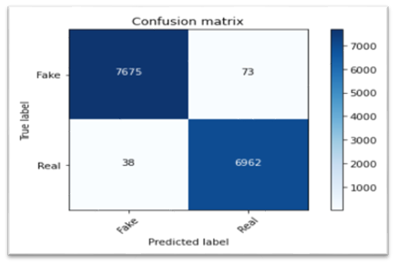
ALGORITHM EVALUATION
Passive Aggressive Classifier:
We got an accuracy of 99.25% with this model. Finally, let us print out a confusion matrix to gain insight into the number of false and true negatives and positives.

Slide 13
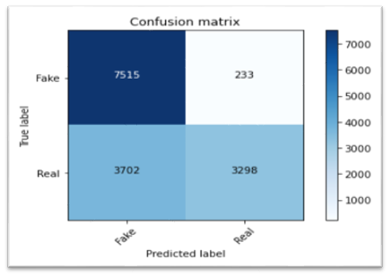
ALGORITHM EVALUATION
KNN (K-Nearest Neighbor)
We got an accuracy of 73% with this model. Finally, let’s print out a confusion matrix to gain insight into the number of false and true negatives and positives.

Slide 14

ALGORITHM EVALUATION
Decision Tree:
We got an accuracy of 94.4% with this model. Finally, let’s print out a confusion matrix to gain insight into the number of false and true negatives and positives.

Slide 15
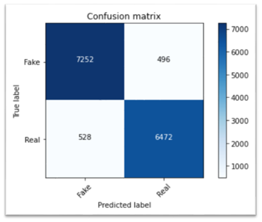
ALGORITHM EVALUATION
Naïve Bayes Classifier:
We got an accuracy of 93% with this model. Finally, let’s print out a confusion matrix to gain insight into the number of false and true negatives and positives.

Slide 16

ALGORITHM EVALUATION
Random Forest:
We got an accuracy of 99% with this model. Finally, let’s print out a confusion matrix to gain insight into the number of false and true negatives and positives.

Slide 17
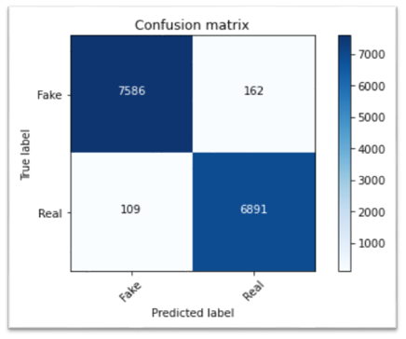
ALGORITHM EVALUATION
Logistic Regression:
We got an accuracy of 99% with this model. Finally, let’s print out a confusion matrix to gain insight into the number of false and true negatives and positives.

Slide 18
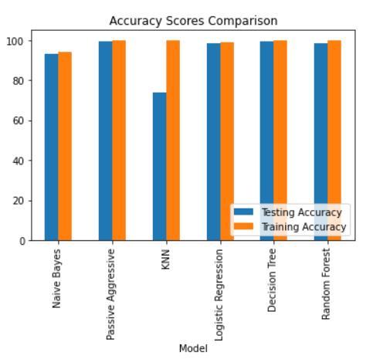
CANDIDATE ALGORITHM SELECTION
All the models are compared using the test and train accuracy scores. Accuracy is used to compare the models as we have enough observations for the analysis and there is only minimal class imbalance.

Slide 19
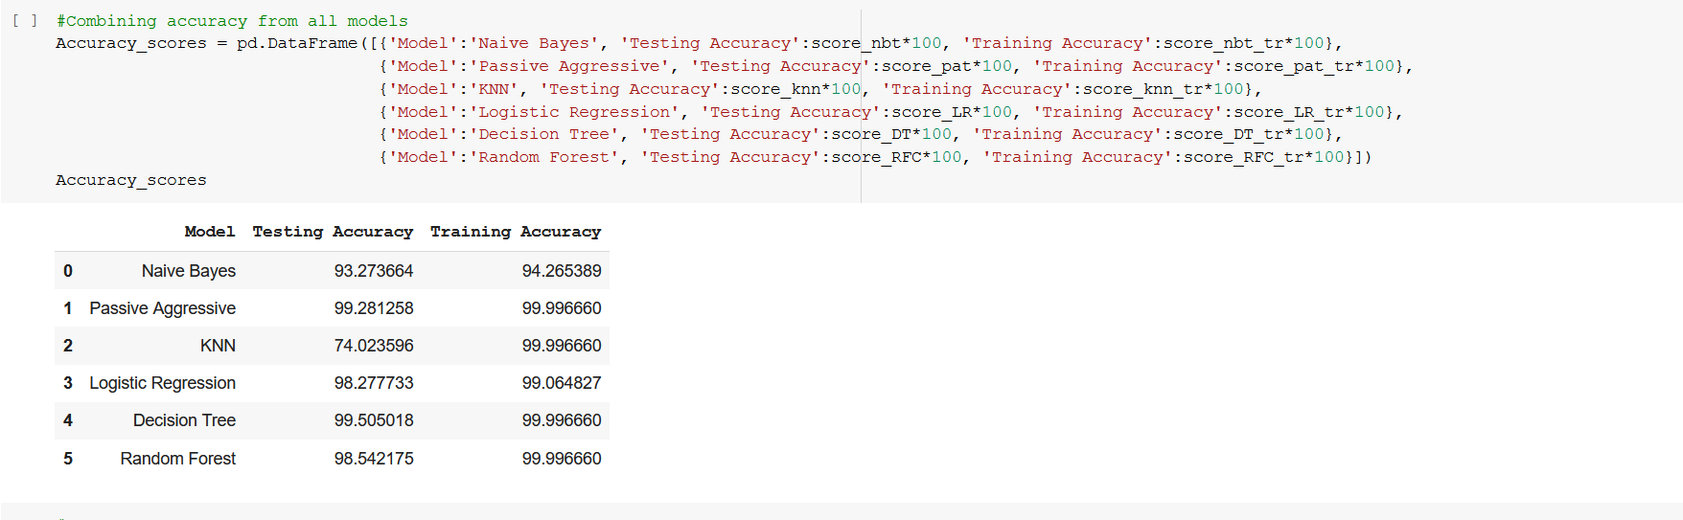
CANDIDATE ALGORITHM SELECTION
Combining accuracy rate of all models.
KNN and Naïve Bayes models have the least accuracy scores and are excluded from further analysis. All other models have very high testing and training accuracy. Among the rest of the models, Decision Tree model has the highest testing accuracy (99.5%), followed by Passive Aggressive model (99.3%). Random Forest and Logistic Regression models have 98% testing accuracy as well. Decision Tree model is selected as the final model for the analysis.

Slide 20
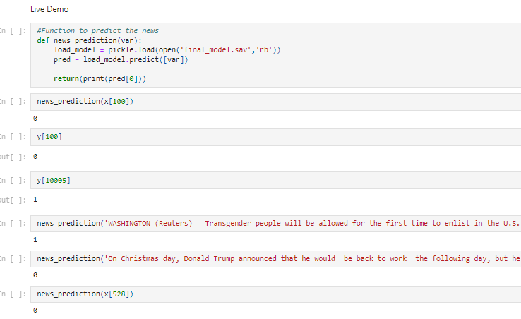
INFERENCE
Decision Tree model is selected as the final model for the analysis based on the accuracy scores.

Slide 21
THANK YOU

